Slide 1

Introduction into fMRI analysis. PsyMsc4 (Goethe 2021).
Session-2
Javier Ortiz-Tudela and Francesco Pupillo
1
Notes:
1

Slide 2
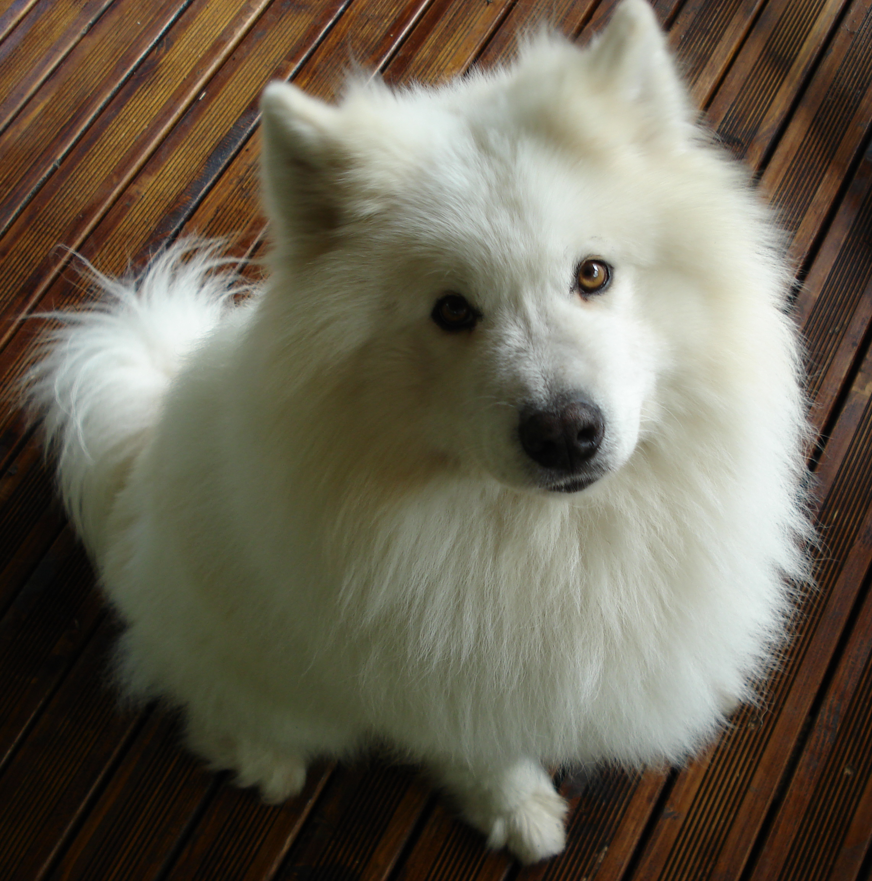

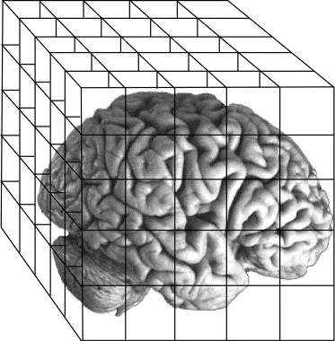
Recap of last week
MR basics:
- Scanner = magnet + RF transmitter
- MRI relies on the magnetic properties of the tissue.
- MR images are 3D “pictures” composed of voxels with one value per voxel.
- Most common 3D files: NifTi (.nii) and compressed NifTi (nii.gz).
- Spatial resolution depends on scanner strength.
QUESTIONS?
Type of images:
MR images can be roughly grouped into anatomical and functional images.
Anatomical images (usually one volume) have higher spatial resolution than functional images (usually several volumes).
TR = time to collect one brain volume.
Preprocessing:
- Slice-time correction
- Magnetic field distortions
- Intensity inhomogeneities
- Motion correction
- Registration
- Normalization
2
Notes:
2

Slide 3
Recap of last week
MR images are a collection of voxels (3D matrix) with a value (a number) in each cell.
The value represents a different thing for anatomical and functional images.
3
Notes:
3

Slide 4
Functional MRI. BOLD signal.
Functional images are used to study brain activity.
But what does brain activity look like when looked through a MR scanner?
4
Notes:
4

Slide 5
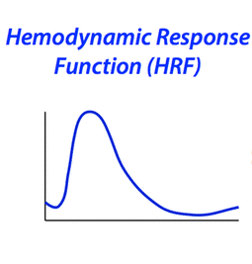
Functional MRI. BOLD signal.
Functional images are used to study brain activity.
What we are recording in our functional sequences is actually blood oxygen level dependent​ (BOLD) signal.
But what does brain activity (BOLD) look like when looked through a MR scanner?
5
Notes:
5

Slide 6
Functional MRI. BOLD signal.
Rise
Undershoot
Initial dip
0s
~15s
Recovery
6
Notes:
6

Slide 7
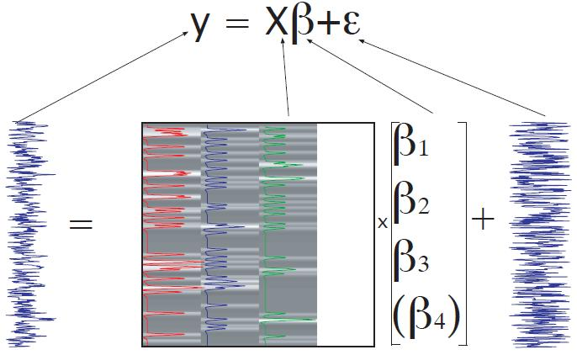
Functional MRI. BOLD signal.
This is the ‘ideal’ response to stimulation but, of course, the measured signal is noisier.
Measured signal in 1 voxel over many volumes
Time
7
Notes:
7

Slide 8
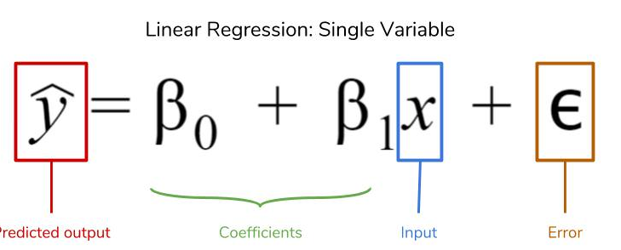
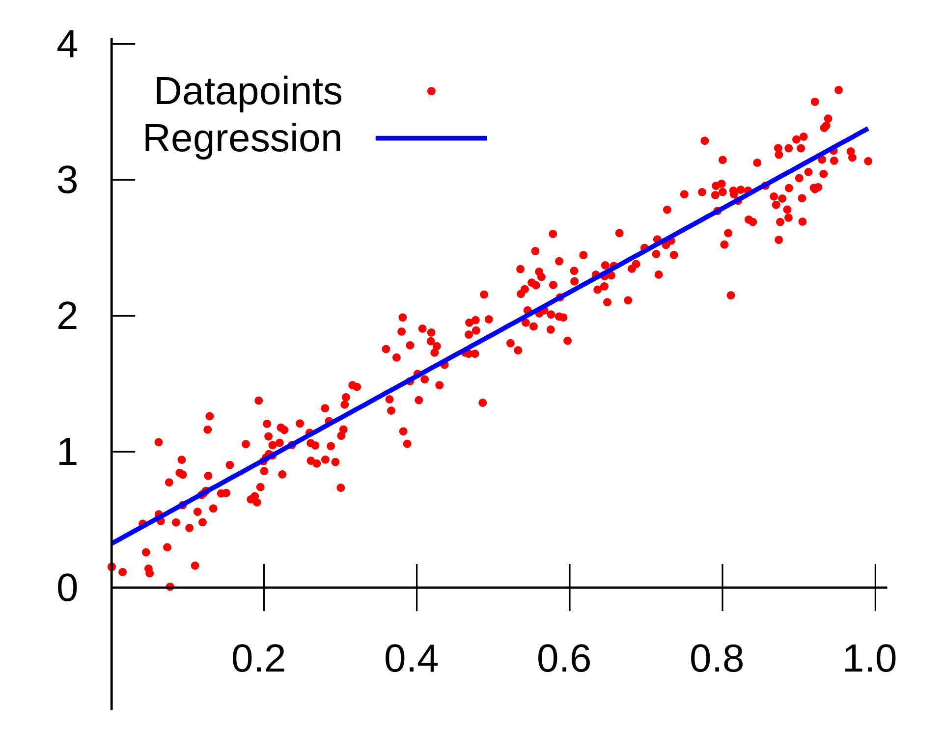
GLM. Generalized Linear Models
If you remember your stats class…
Intercept
Slope
from Wikipedia
8
Notes:
8

Slide 9
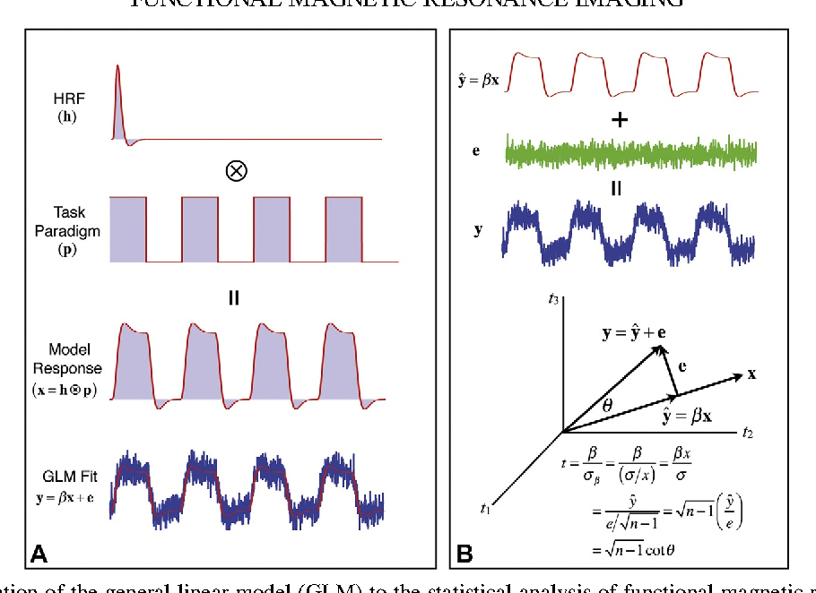
GLM. Generalized Linear Models
Regression is the usual approach for analysis of fMRI signals.
Measured signal in 1 voxel over many volumes
Time
Present
Absent
Time
9
Notes:
9

Slide 10

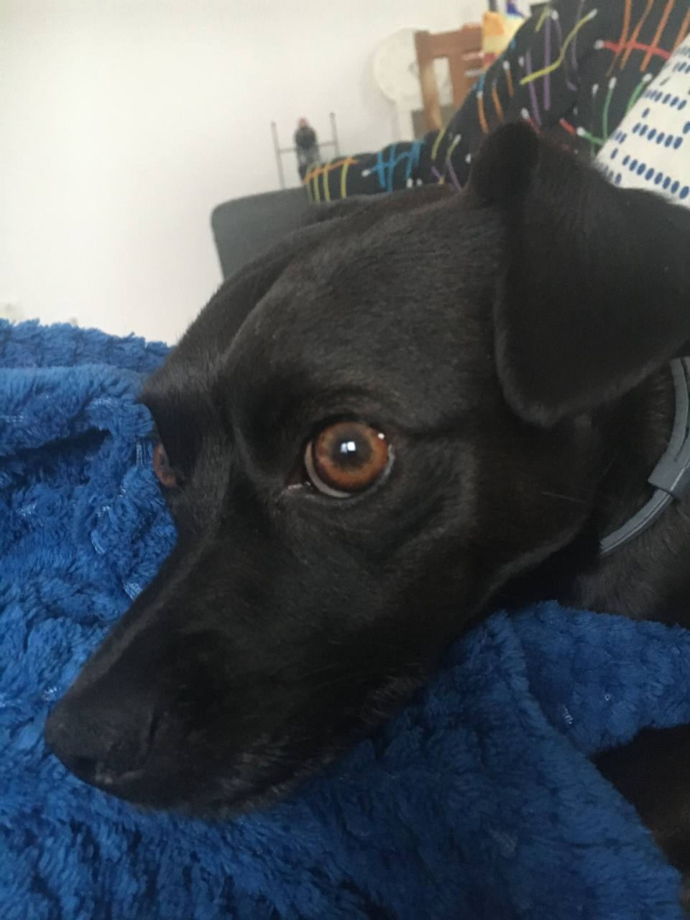
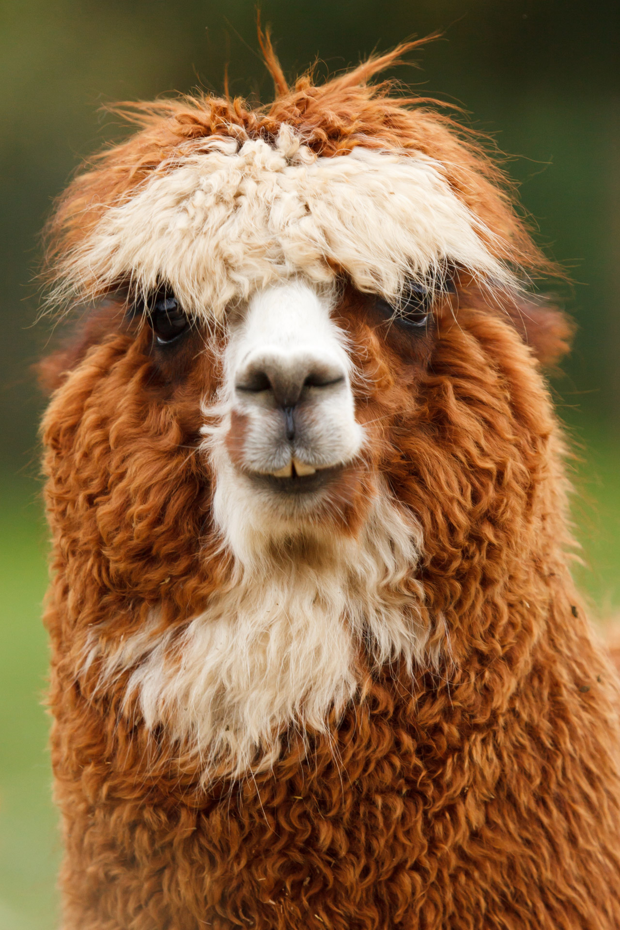
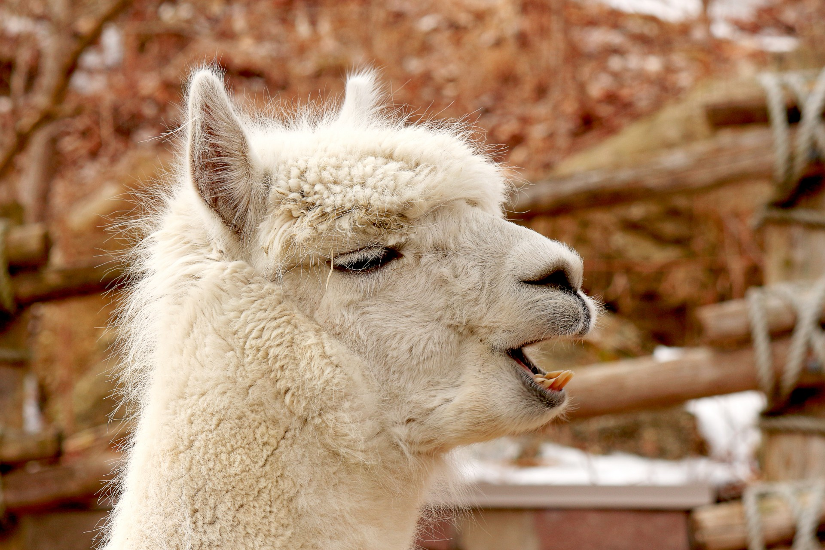
GLM
A practical example. Can we find voxels that respond to ANIMAL FACES?
Task
(visual stim.)
+
+
+
Voxel
activity
Time
Task
model
Present
Absent
Time

Slide 11
GLM
A practical example. Can we find voxels that respond to ANIMAL FACES?
Task
(visual stim.)
+
+
+
Voxel
activity
Time
Task
model
Present
Absent
Time

Slide 12
GLM
A practical example. Can we find voxels that respond to ANIMAL FACES?
Voxel
activity
Time
Task
model
Present
Absent
Time
Response
model

Slide 13
GLM
A practical example. Can we find voxels that respond to ANIMAL FACES?
Voxel
activity
Time
Now we can use regression to obtain an estimate (beta) of how much our response model explains our BOLD signal in our voxel.
Task
model
Present
Absent
Time
Response
model

Slide 14
GLM
A practical example. Can we find voxels that respond to ANIMAL FACES?
If run for every voxel, we will get one beta estimate per voxel, i.e., a beta map
Voxel
activity
Time
Task
model
Present
Absent
Time
Response
model

Slide 15
GLM
A practical example. Can we find voxels that respond to ANIMAL FACES?
QUESTION: What would the value in each voxel of the beta map represent?
Voxel
activity
Time
Task
model
Present
Absent
Time
Response
model

Slide 16
GLM
A practical example. Can we find voxels that distinguish to DOGS FACES from ALPACAS FACES?
Voxel
activity
Time
Task
model
Present
Regressor 1
Absent
Regressor 2
Time

Slide 17
GLM
A practical example. Can we find voxels that distinguish to DOGS FACES from ALPACAS FACES?
If run for every voxel, we will get one beta estimate per voxel, i.e., a beta map
Voxel
activity
Time
Task
model
Present
Absent
Time

Slide 18
GLM
A practical example. Can we find voxels that distinguish to DOGS FACES from ALPACAS FACES?
QUESTION: What would the value in each voxel of the beta map represent?
Voxel
activity
Time
Task
model
Present
Absent
Time

Slide 19

Part I. Basics of MRI
19
Notes:
19

Slide 20
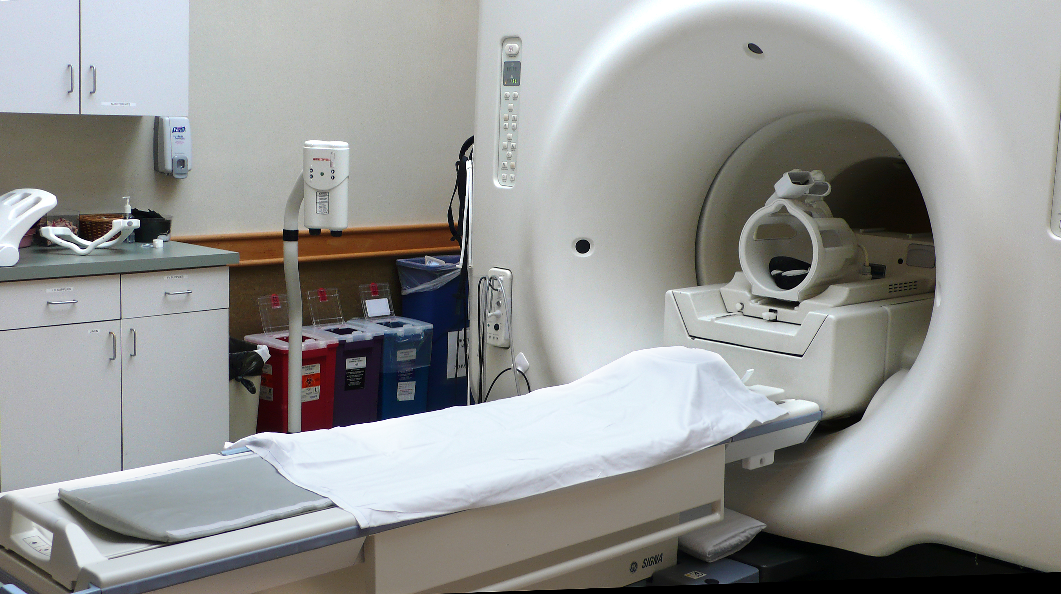
Here are the basics of MR imaging
20
Notes:
20

Slide 21
Here are the basics of MR imaging
Scanner
Coil
Bed
21
Notes:
21

Slide 22
Here are the basics of MR imaging
Scanner =
big magnet + radio frequency transmitter
big and very strong!
CAUTION!!
loud and annoying!
CAUTION!!
22
Notes:
22

Slide 23
Here are the basics of MR imaging
Scanner =
big magnet + radio frequency transmitter
MAGNETIC FIELD
Hidrogen protons
When you put something inside a magnetic field, its H protons align (their spin) to the magnetic field.
23
Notes:
23

Slide 24
Here are the basics of MR imaging
Scanner =
big magnet + radio frequency transmitter
MAGNETIC FIELD
Hidrogen protons
An RF pulse can tilt the orientation of the proton (‘s spin)
24
Notes:
24

Slide 25
Here are the basics of MR imaging
Scanner =
big magnet + radio frequency transmitter
MAGNETIC FIELD
Coil =
RF receiver
Hidrogen protons
When the RF pulse stops, the proton goes back to normal emitting another RF signal.
25
Notes:
25

Slide 26
Here are the basics of MR imaging
Scanner =
big magnet + radio frequency transmitter
MAGNETIC FIELD
Hidrogen protons
Different points in space have different relaxation times, and we can use those differences to reconstruct what is inside the scanner.
26
Notes:
26

Slide 27
So… What are MR images?
If we zoom in, we can see that images are composed of pixels.
27
Notes:
27

Slide 28
So… What are MR images?
28
Notes:
28

Slide 29
So… What are MR images?
When we have a 3D image, we talk about voxels.
29
Notes:
29

Slide 30
So… What are MR images?
Voxel size determines our image resolution: smaller = better.
Resolution is (partly) dependent on the strength of the magnetic field.
Common resolutions for different strengths:
1.5 Tesla ~ 3x3x3
3 Tesla ~ 2x2x2
7 Tesla ~ 0.8x0.8x.0.8
30
Notes:
30

Slide 31
So… What are MR images?
Voxel size determines our image resolution: smaller = better.
Resolution is (partly) dependent on the strength of the magnetic field.
Common resolutions for different strengths:
1.5 Tesla ~ 3x3x3
3 Tesla ~ 2x2x2
7 Tesla ~ 0.8x0.8x.0.8
31
Notes:
31

Slide 32
Part II. Types of MR images
32
Notes:
32

Slide 33
Types of MR images*
Anatomical images
Functional images
*For the purpose of this seminar only these two types will be covered since they are essential for standard fMRI analysis.
33
Notes:
33

Slide 34
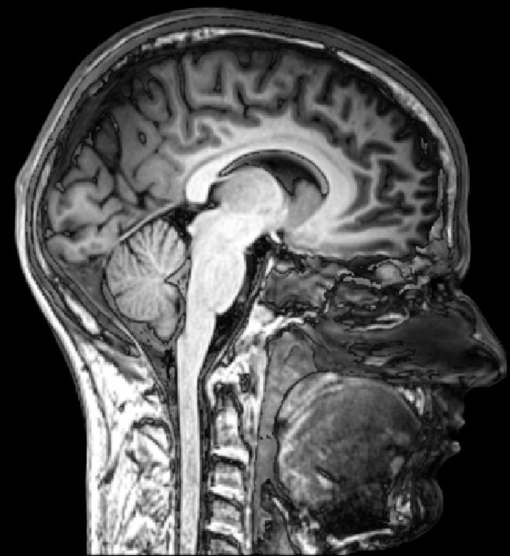
Types of MR images*
Anatomical images
(T1w)
Functional images
Aim:
Structure
Feats:
Good spatial resolution.
Task free.
Slow acquisition
(~5 min full brain)
Differences in signal strength caused by different tissue types.
34
Notes:
34

Slide 35
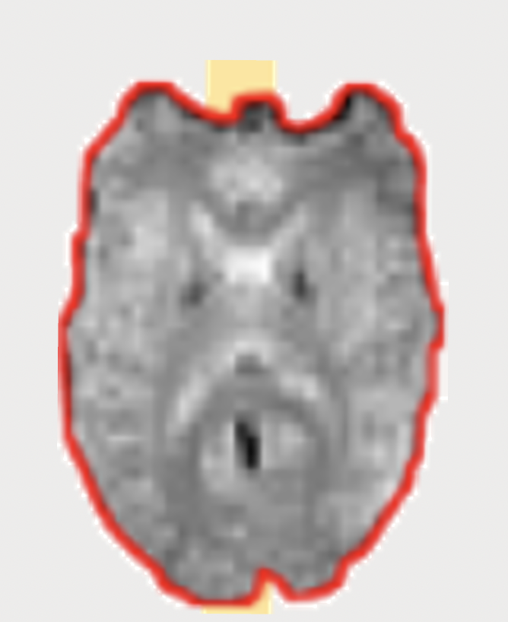
Types of MR images*
Functional images
T2*
Anatomical images
Aim:
Activity
Feats:
“Good” time resolution.
Measures blood flow.
Task sensitive.
Fast acquisition
(~2s full brain)
Differences in signal strength caused by distortions in the magnetic field.
35
Notes:
35

Slide 36
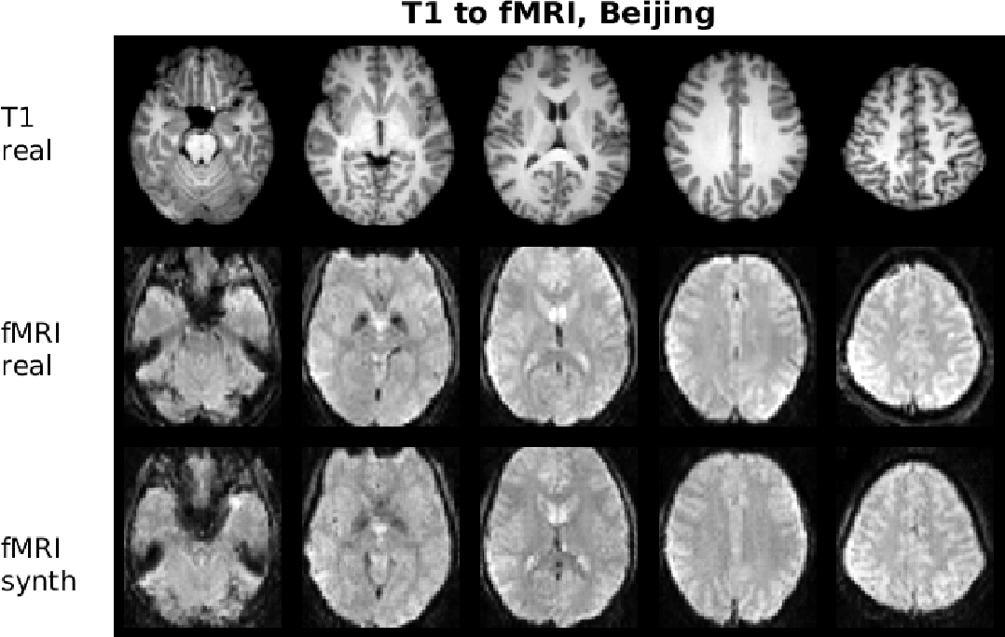
Types of MR images*
Anatomical images
Functional images
How to distinguish them?
Inverse contrast!
36
Notes:
36

Slide 37
Types of MR images*
Anatomical images
Functional images
How to distinguish them?
Inverse contrast!
T1w:
Grey matter – dark
White matter - bright
T2:
Grey matter – bright
White matter - dark
37
Notes:
37

Slide 38
Types of MR images*
Anatomical images
Functional images
How to distinguish them?
Functional images have (usually) lower spatial resolution.
Gain in time resolution!
time
38
Notes:
38

Slide 39
Types of MR images*
Anatomical images
Functional images
How to distinguish them?
TR = time to sample the entire field (to collect one brain volume).
time
TR
TR
TR
TR
TR
TR
TR
TR
TR
TR
TR
TR
39
Notes:
39

Slide 40
Part II. Recap
Key ideas.
MR images can be roughly grouped into anatomical and functional images.
Anatomical images (usually one volume) have higher spatial resolution than functional images (usually several volumes).
TR = time to collect one brain volume.
40
Notes:
40

Slide 41
Part III. Image preprocessing
41
Notes:
41

Slide 42
Preprocessing.
Why?
MR images as a reconstruction problem > This process is never perfect.
Distortions in MR images can be grouped in two types: temporal and spatial.
42
Notes:
42

Slide 43
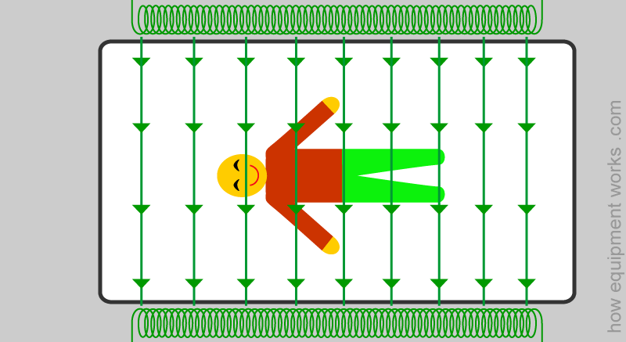
Preprocessing.
Why?
MR images as a reconstruction problem > This process is never perfect.
Distortions in MR images can be grouped in two types: temporal and spatial.
If collecting this entire volume takes 2s (TR=2s), it means that the top slice was acquired ~2 after the bottom one!
0s
Acquisition order
TRs
43
Notes:
43

Slide 44
Preprocessing.
Why?
MR images as a reconstruction problem > This process is never perfect.
Distortions in MR images can be grouped in two types: temporal and spatial.
If collecting this entire volume takes 2s (TR=2s), it means that the bottom slice was acquired ~2 after the top one!
0s
Acquisition order
TRs
Time
0s
TRs
44
Notes:
44

Slide 45
Preprocessing.
Why?
MR images as a reconstruction problem > This process is never perfect.
Distortions in MR images can be grouped in two types: temporal and spatial.
Slice time correction
0s
Acquisition order
TRs
Time
0s
TRs
45
Notes:
45

Slide 46
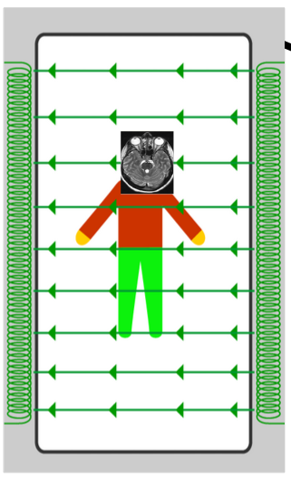
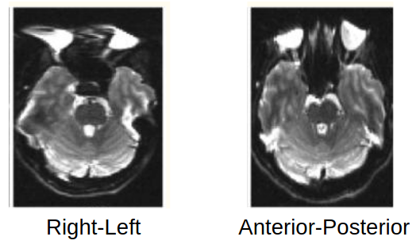
Preprocessing.
Why?
MR images as a reconstruction problem > This process is never perfect.
Distortions in MR images can be grouped in two types: temporal and spatial.
“Magnetic field inhomogeneities, caused by susceptibility differences at tissue/air and tissue/bone interfaces, result in significant geometric and intensity distortions. The challenge of reducing these field inhomogeneity effects arises from their spatial dependence. Data from different spatial locations are corrupted to different degrees, with the amount of corruption determined by the local magnetic field environment.” (Gholipour, et al., 2011).
Magnetic field inhomogeneities
46
Notes:
46

Slide 47
Preprocessing.
Why?
MR images as a reconstruction problem > This process is never perfect.
Distortions in MR images can be grouped in two types: temporal and spatial.
Magnetic field inhomogeneities
While some minor field inhomogeneity can be corrected by shimming, much of it cannot…
Two main approaches to tackle the resulting distortions:
- Field map, i.e., acquiring a map of the magnetic field
- Blip up – blip down, i.e., acquiring an image in the inverted phase - encoding direction (Holland, Kuperman, & Dale, (2010).
47
Notes:
47

Slide 48
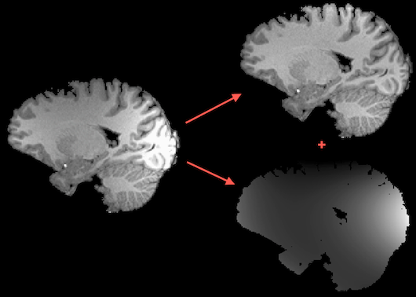
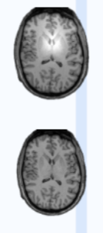
Preprocessing.
Why?
MR images as a reconstruction problem > This process is never perfect.
Distortions in MR images can be grouped in two types: temporal and spatial.
Intensity inhomogeneities
48
Notes:
48

Slide 49
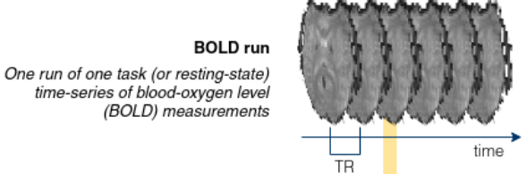
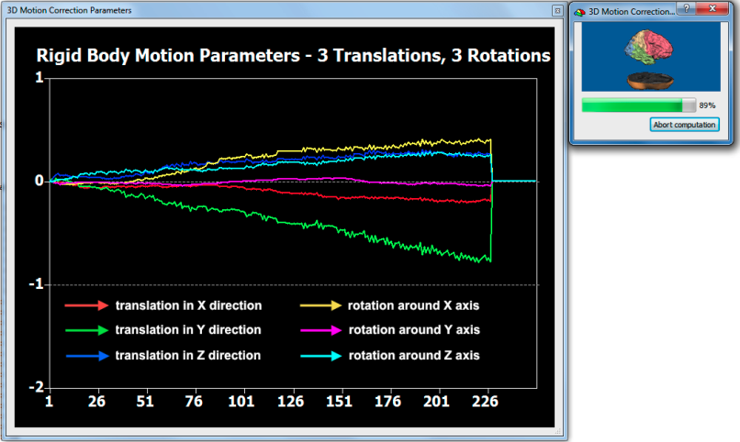
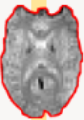
Preprocessing.
Why?
Functional MR images are recorded over time > Participants move!
Volumes need to be re-aligned!
49
Notes:
49

Slide 50
Preprocessing.
Why?
Anatomical and functional MR images are recorded at different time points and with different sequences > Volumes need to be registered to each other!
50
Notes:
50

Slide 51
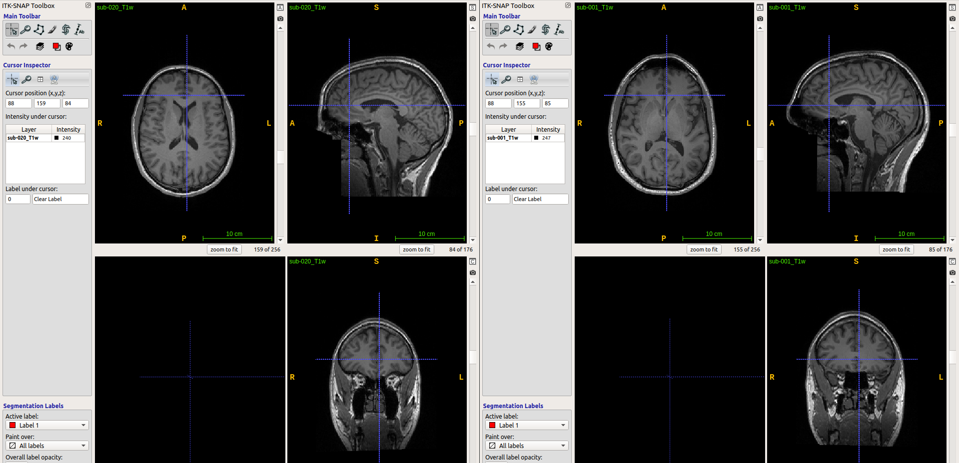
Preprocessing.
Why?
MR images are recorded for multiple individuals > Participants have different brain shapes!
We might want to have a common space for all of them.
51
Notes:
51

Slide 52
Preprocessing.
Why?
MR images are recorded for multiple individuals > Participants have different brain shapes!
Common spaces:
Native
MNI
Sample specific
52
Notes:
52

Slide 53
Part III. Image preprocessing. Recap
Key steps.
- Slice-time correction
- Magnetic field distortions
- Intensity inhomogeneities
- Motion correction
- Registration
- Normalization
53
Notes:
53

Slide 54
Part III. Image preprocessing. Recap
Key steps.
- Slice-time correction
- Magnetic field distortions
- Intensity inhomogeneities
- Motion correction
- Registration
- Normalization
How to do this?
- fMRIprep (https://fmriprep.org)
- SPM
- FSL
- BrainVoyager
- … and more
How to run fMRIPrep on your own:https://gitlab.com/ortizTud/neuroim-methods#010321-tutorial-on-fmriprep-ortiz
54
Notes:
54

Slide 55
Let’s get practical.
Software needed:
MATLAB 2018 or later (https://www.mathworks.com/)
SPM12 (https://www.fil.ion.ucl.ac.uk/spm/software/spm12/)
ITK-Snap 3.8.0 (http://www.itksnap.org/)
Data needed:
Know our repository:
https://github.com/ortiztud/fmri_analysis_intro
All the steps involved in preprocessing take a while to complete (up to several hours sometimes!)
We have already preprocessed all the images with fMRIPrep. You can find them under
~/<project_folder>/preproc_data/fmriprep/
55
Notes:
55

